Slide 1
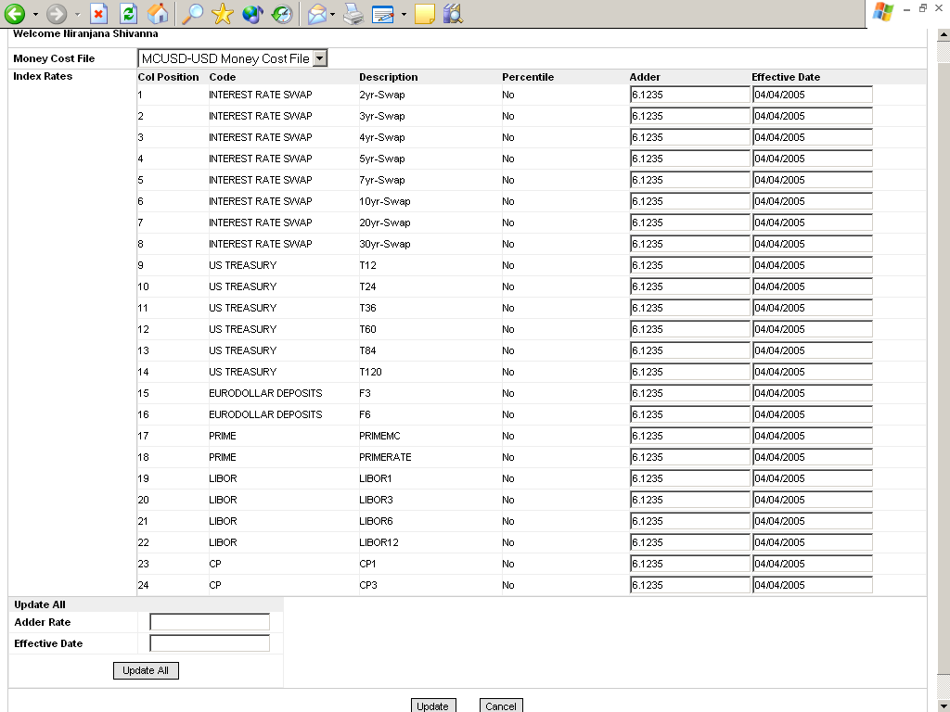
Remove Percentile Column
Add Header / Footer to the page using GE Standard from existing sites. In essence the page is to allow the Pricing Analyst update the Adder Rate information which then has to be used by the Money Cost Service while updating the Money Cost File.
Rename the Update All section and button to Apply All
Move Apply All section up before the Index Rates grid.
Bring all the controls in one row.
Change Text to “Save”

